Slide 1
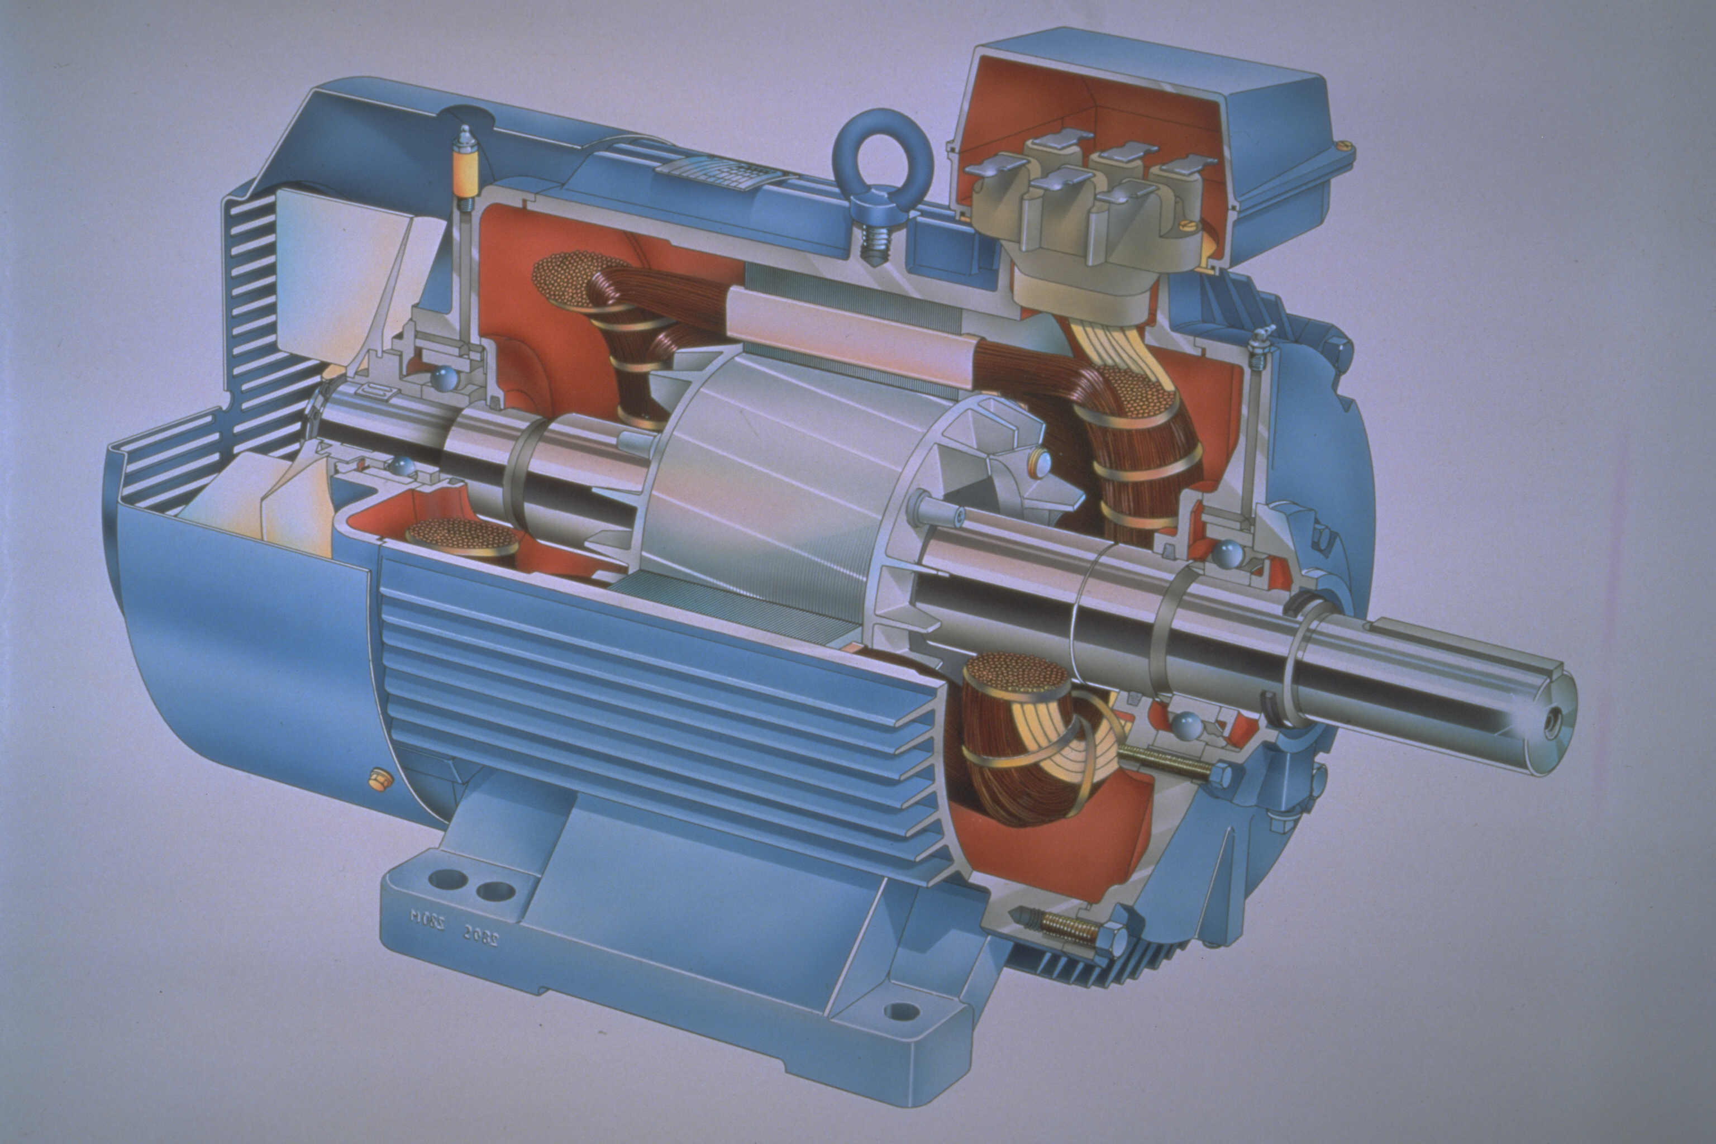
APPLICATION OF
INDUCTION MOTOR
BY – SURAJ SINGH BISHT(4154)
VIGHNESH TIWARI(4159)
BHARAT SWAROOP SHARMA(4111)

Slide 2
WHAT IS INDUCTION MOTOR
An induction motor is simply is an device that converts electrical energy to mechanical energy and induction motors works only on ac supply.

Slide 3
PRINCIPLE
The basic principle of operation of induction motor is—
Faradays law-When an magnetic flux linked with an
conductor changes then an emf is induced in it.
2.Lorrentz law-When an current carrying conductor is
kept in an external magnetic field then force is
exerted on the conductor by the magnetic field.

Slide 4
TYPES OF INDUCTION MOTORS
Single phase AC motors
Three phase AC motors

Slide 5
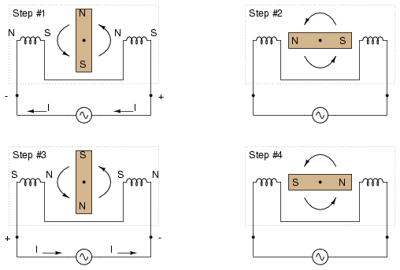
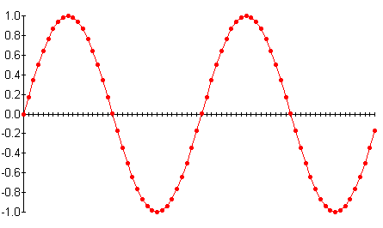
Single phase AC

Slide 6
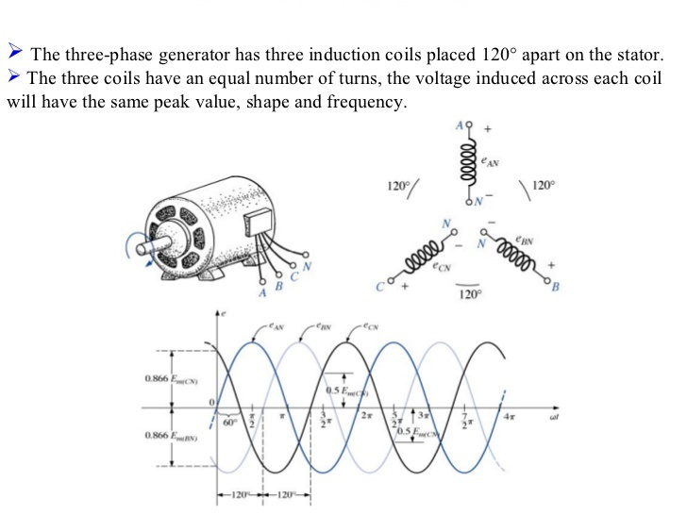
Three phase AC

Slide 7
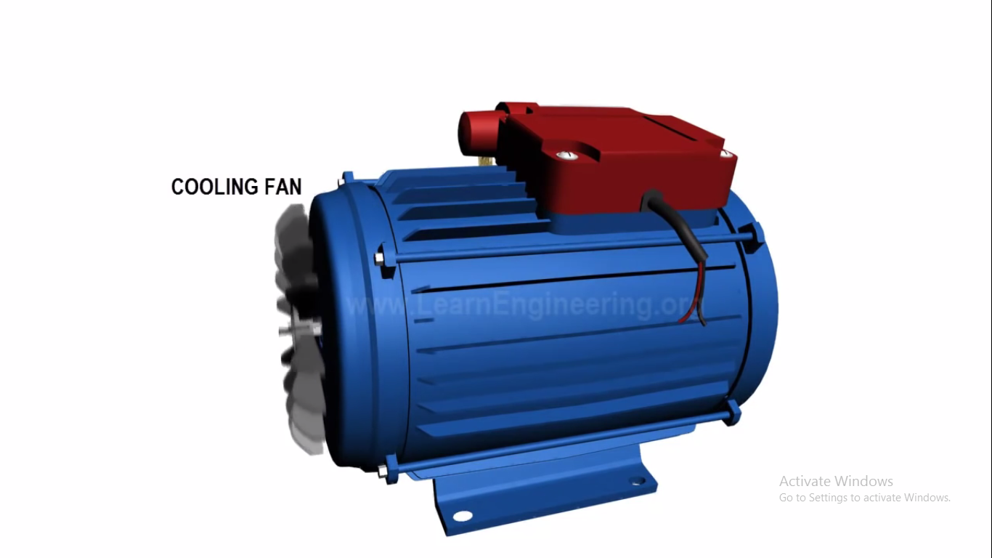
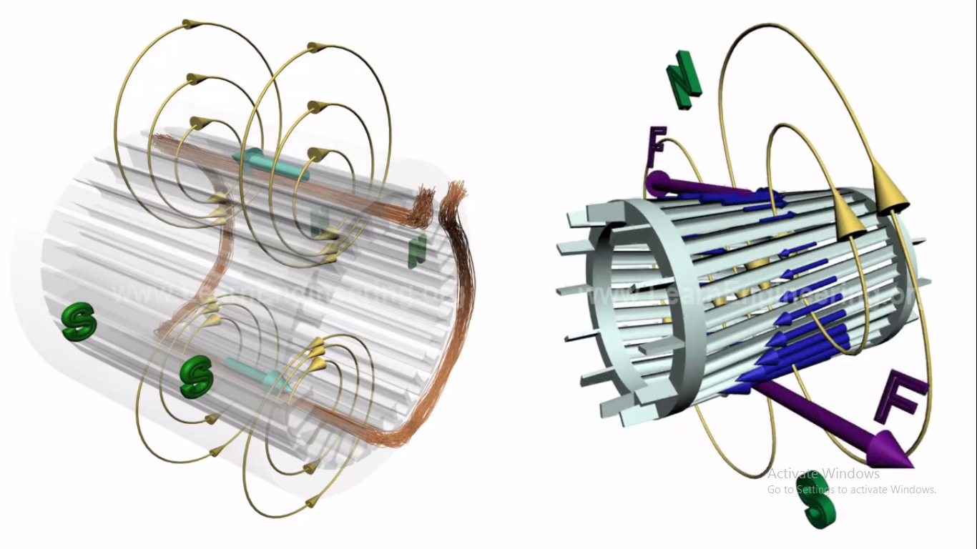
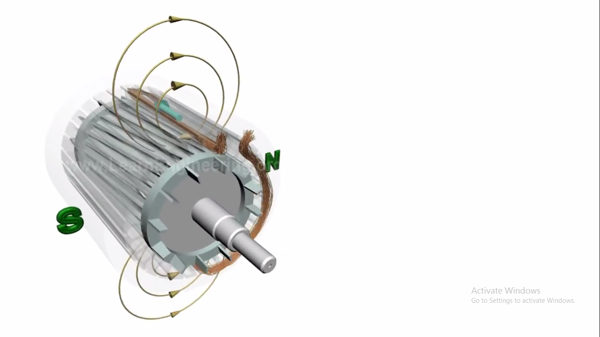
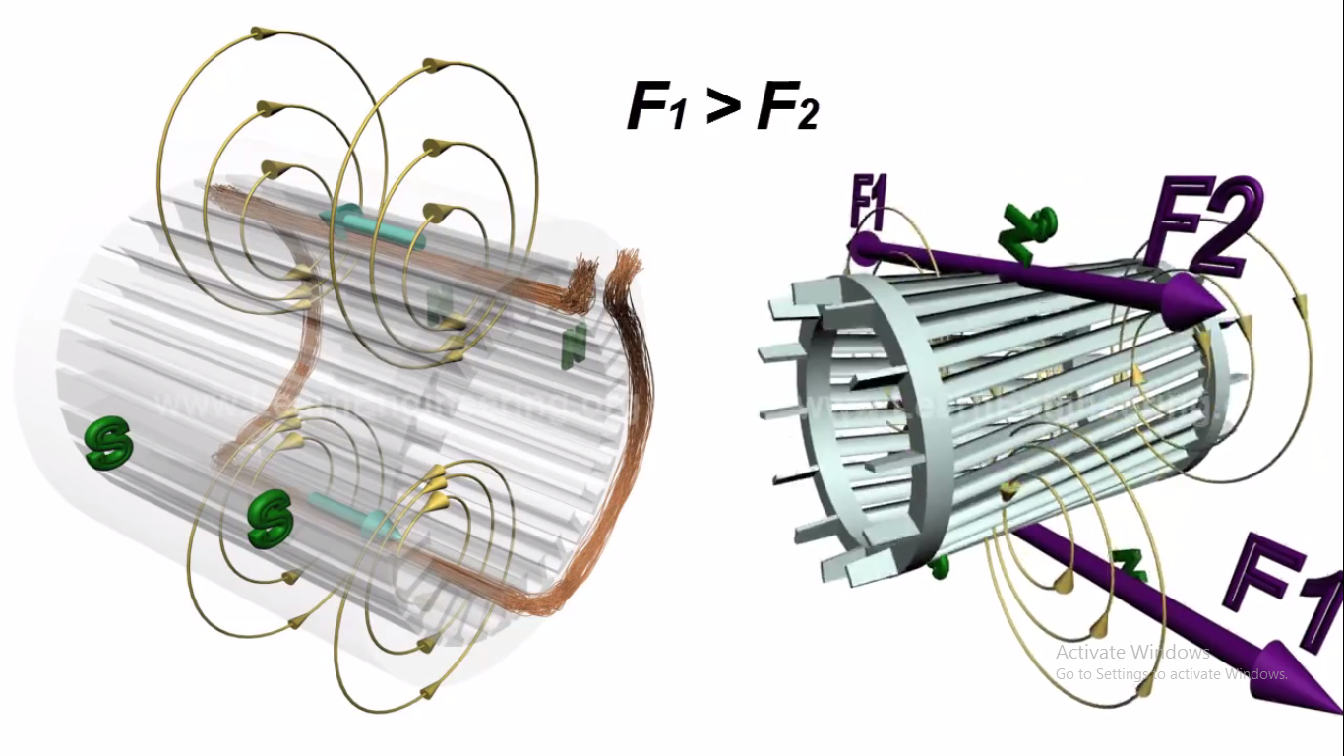
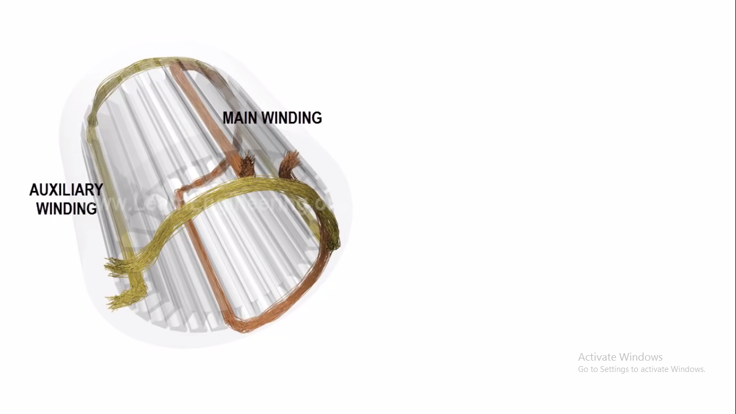
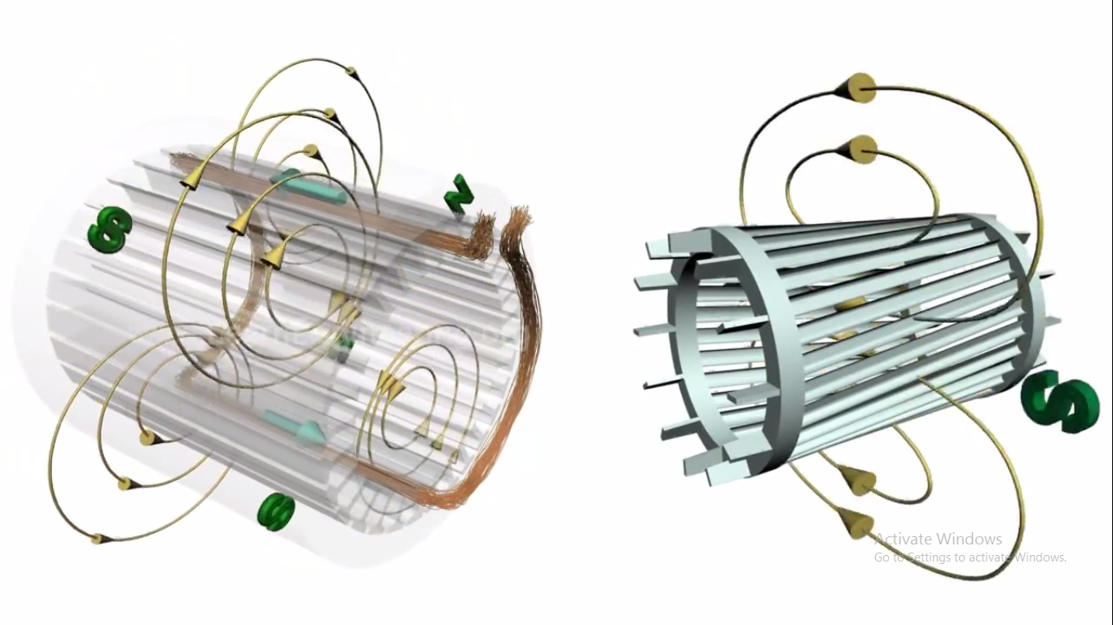
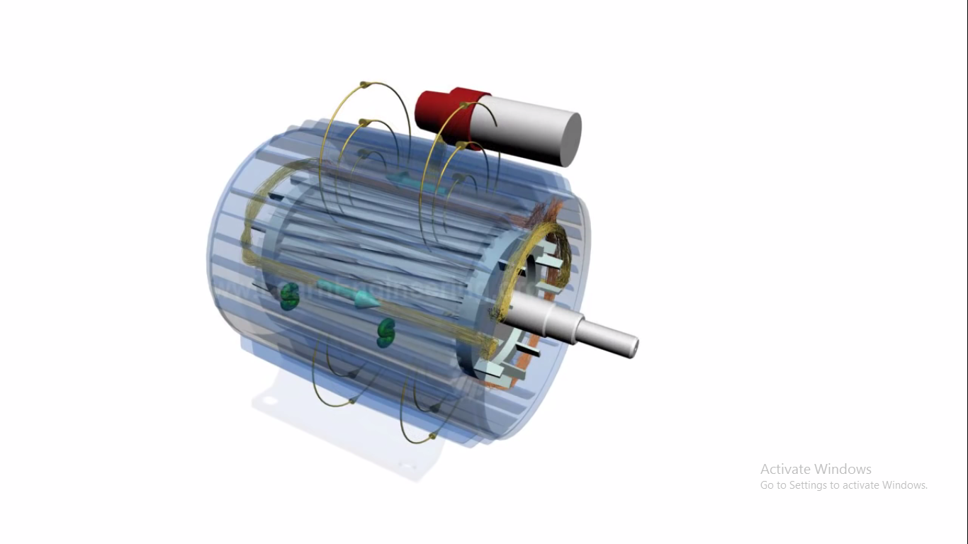
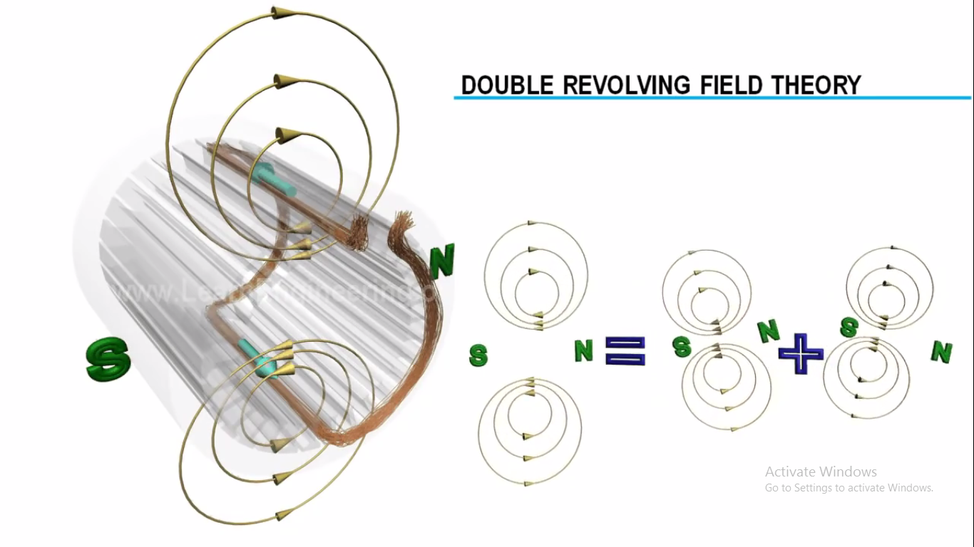
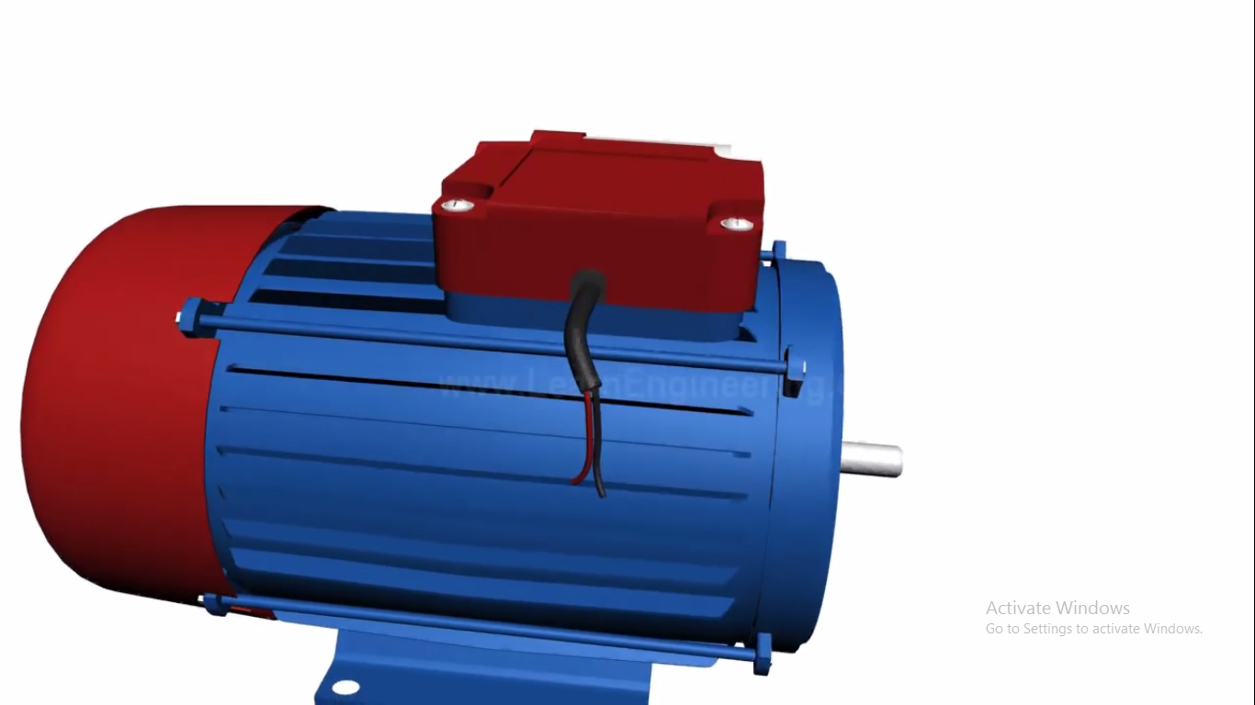
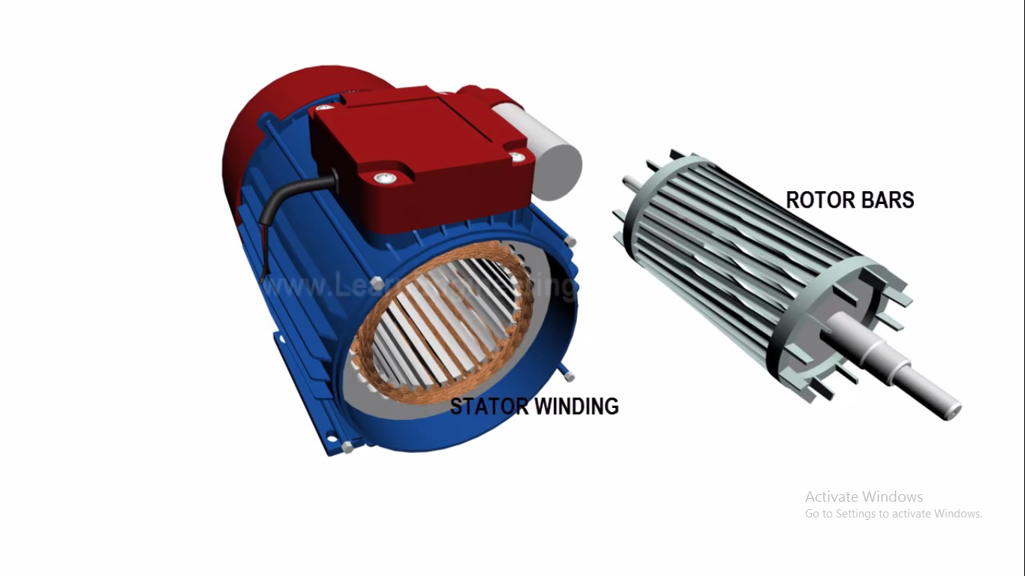
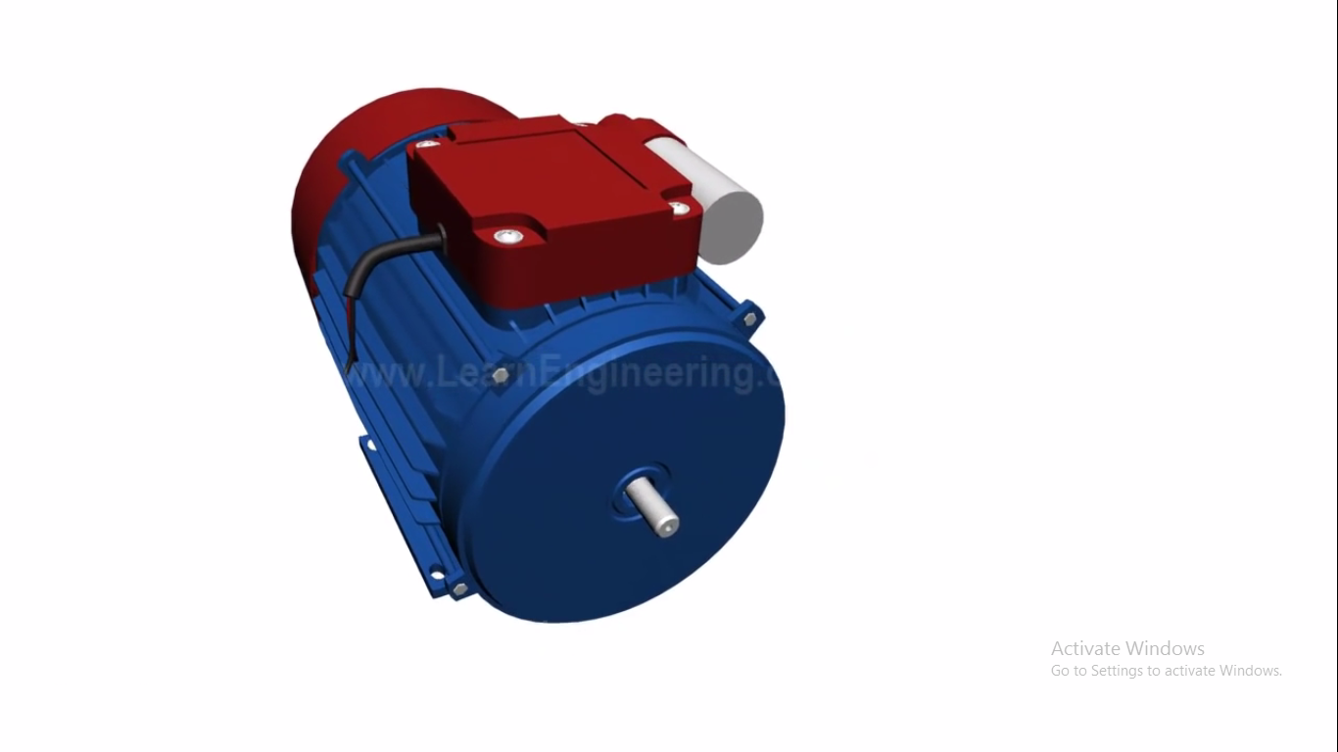
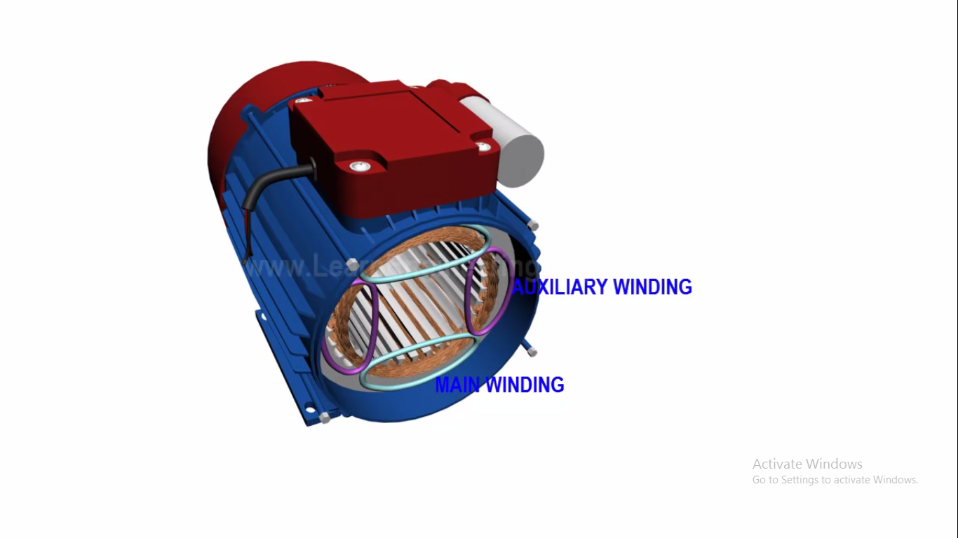
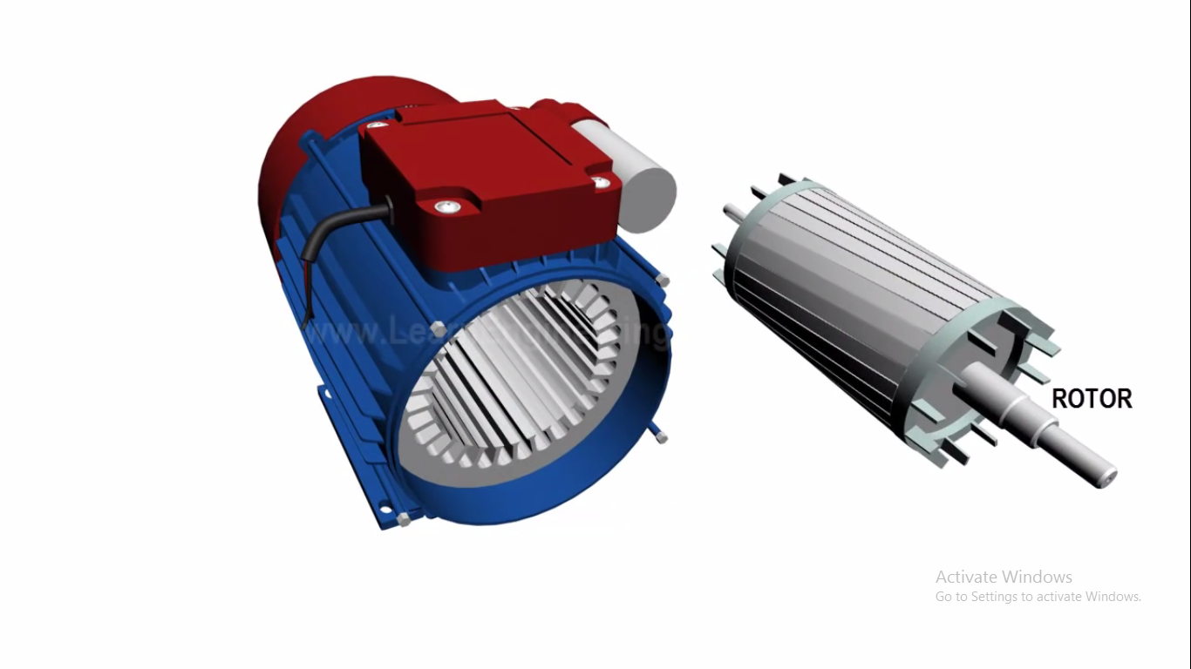
CONSTRUCTION AND WORKING OF SINGLE PHASE AC MOTOR

Slide 8
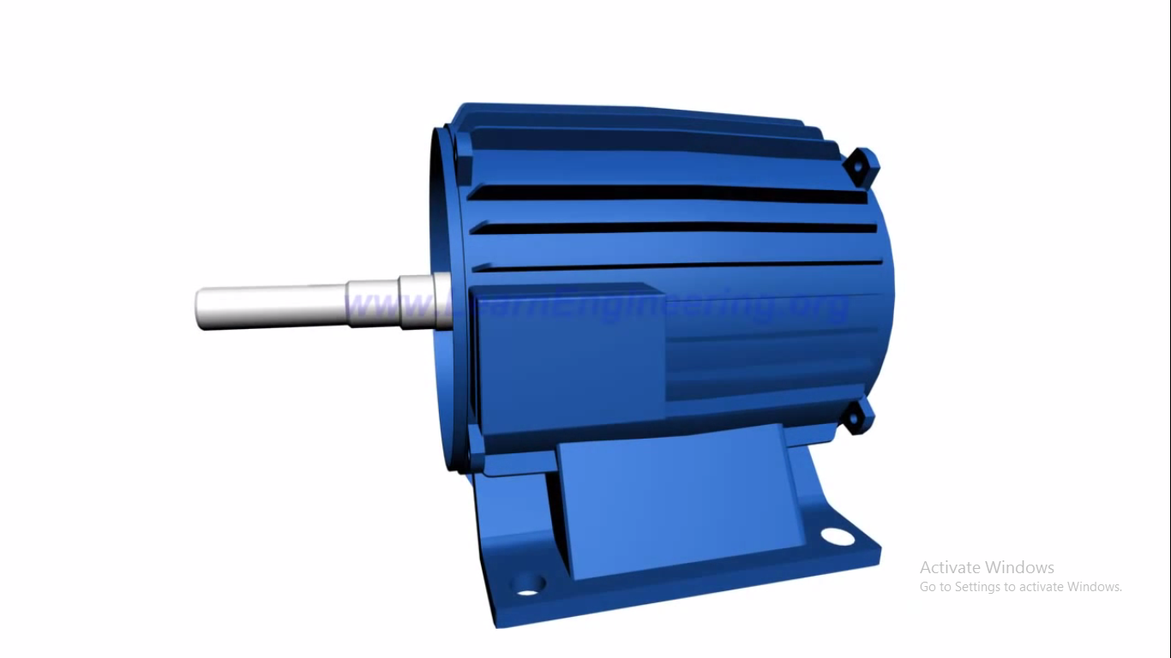
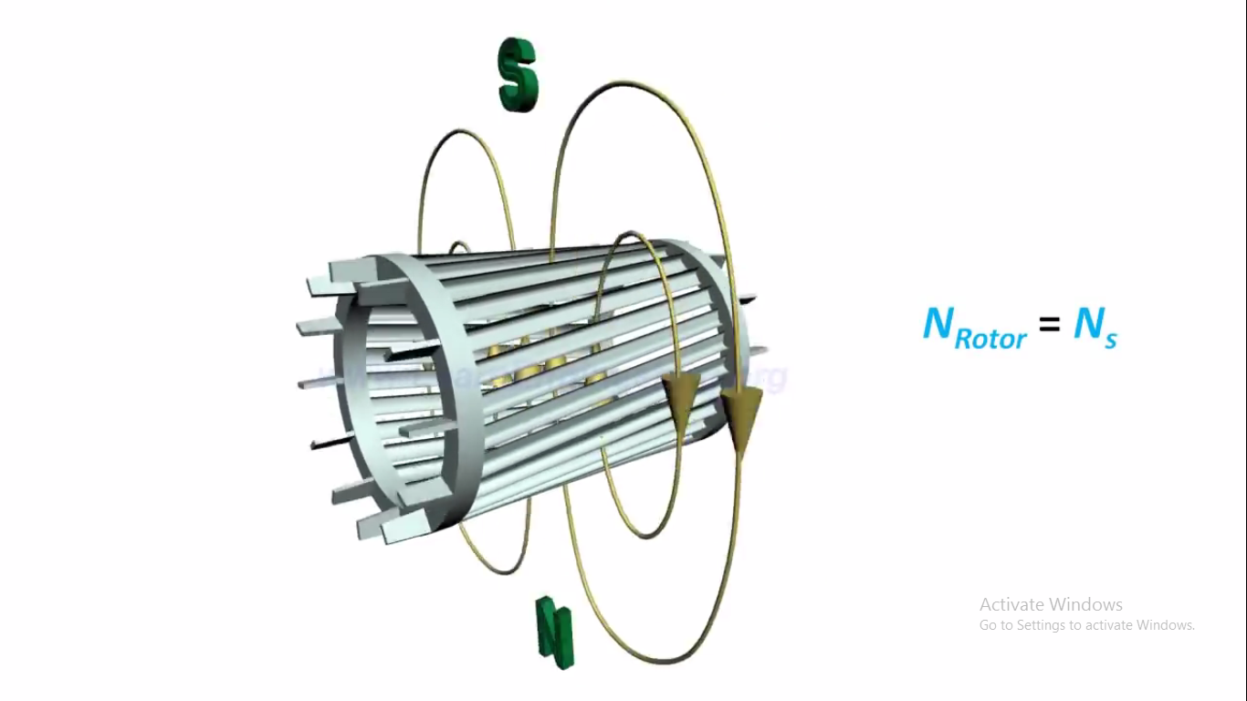
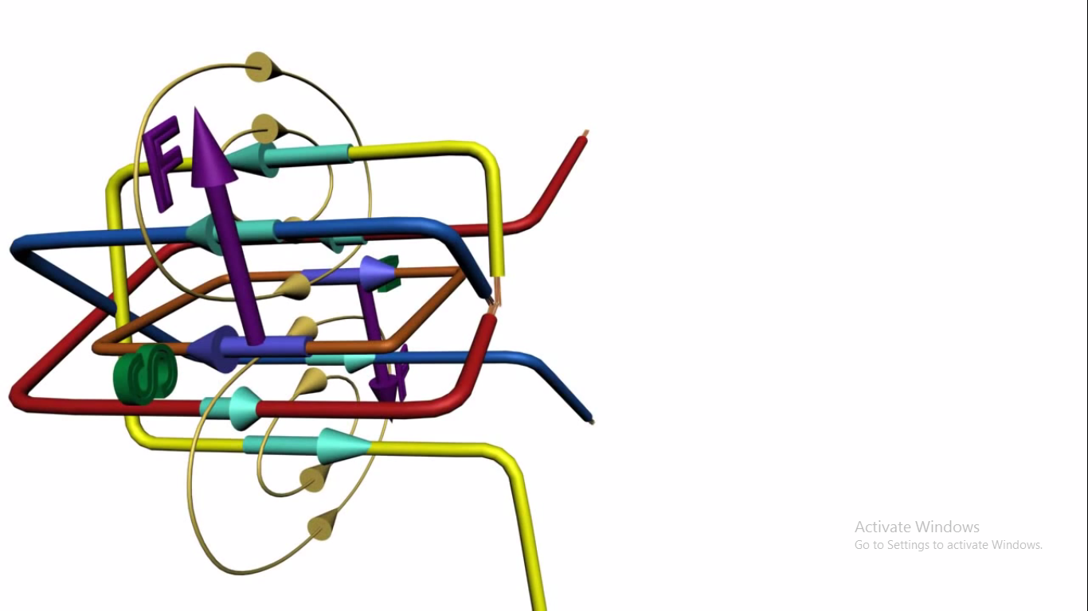
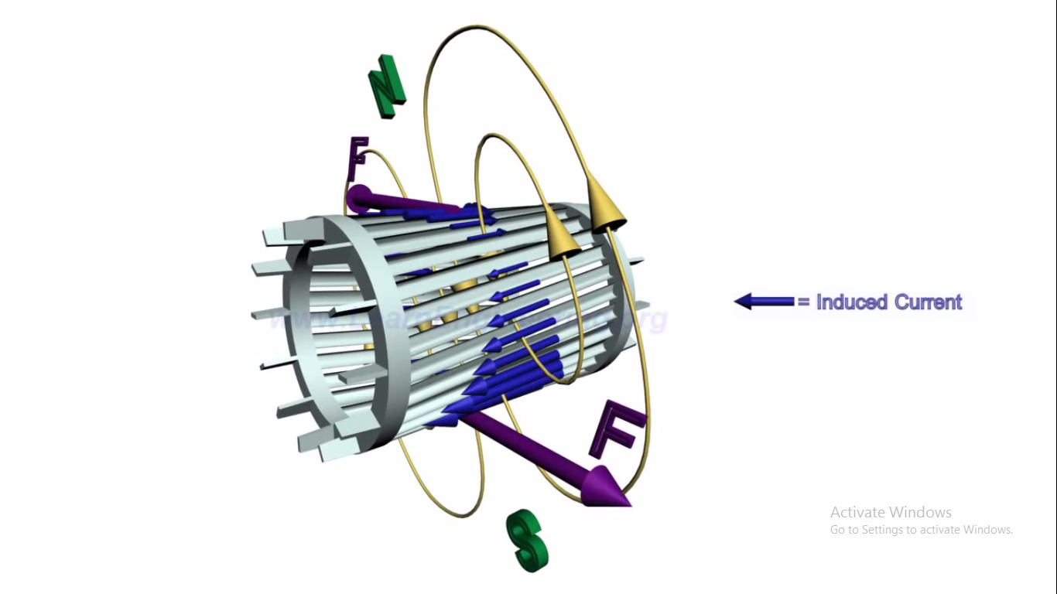
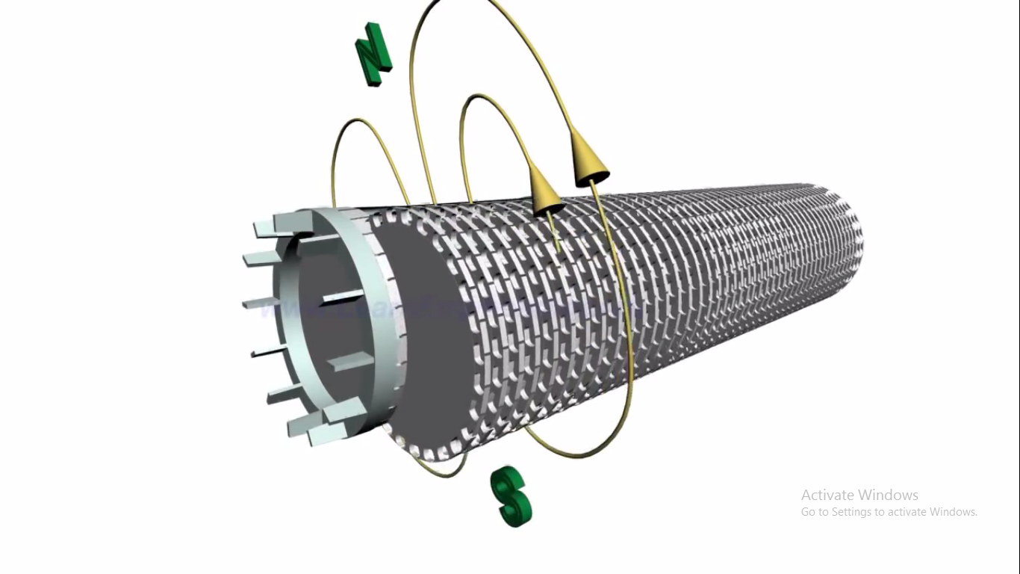
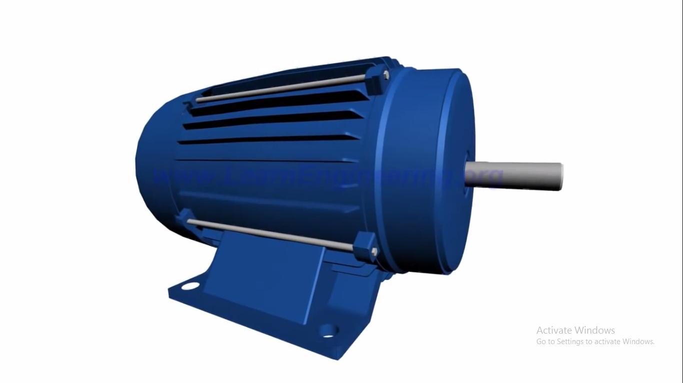
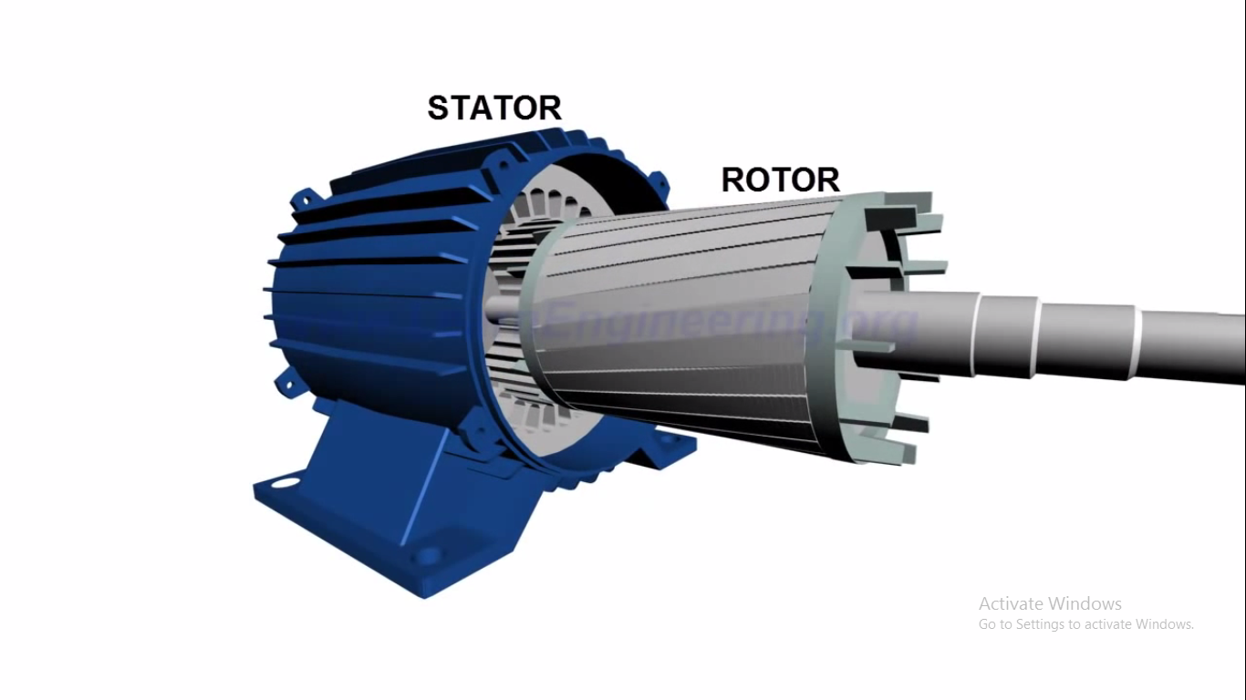
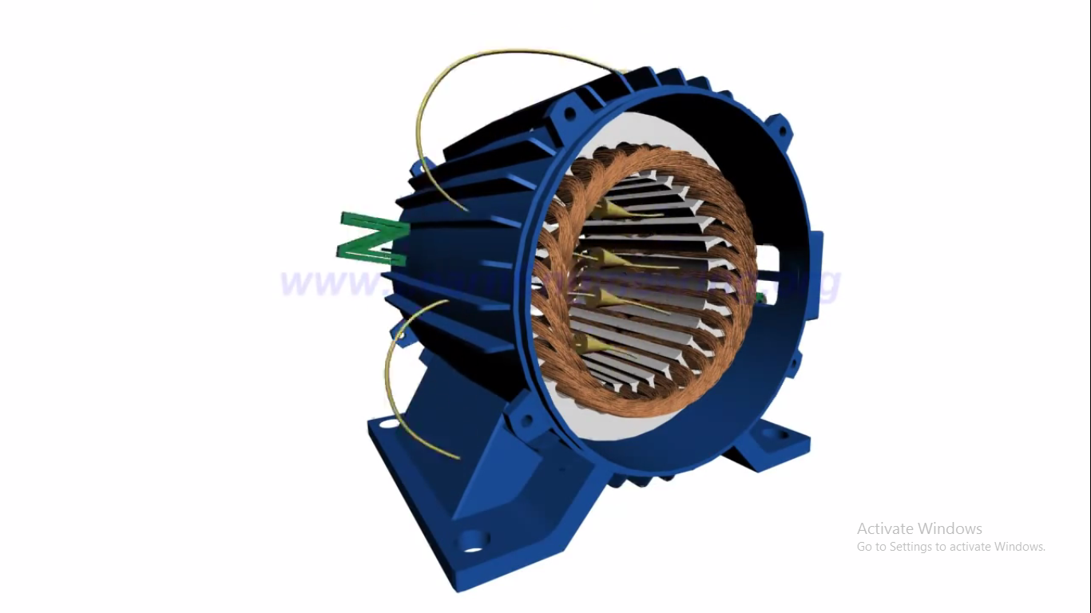
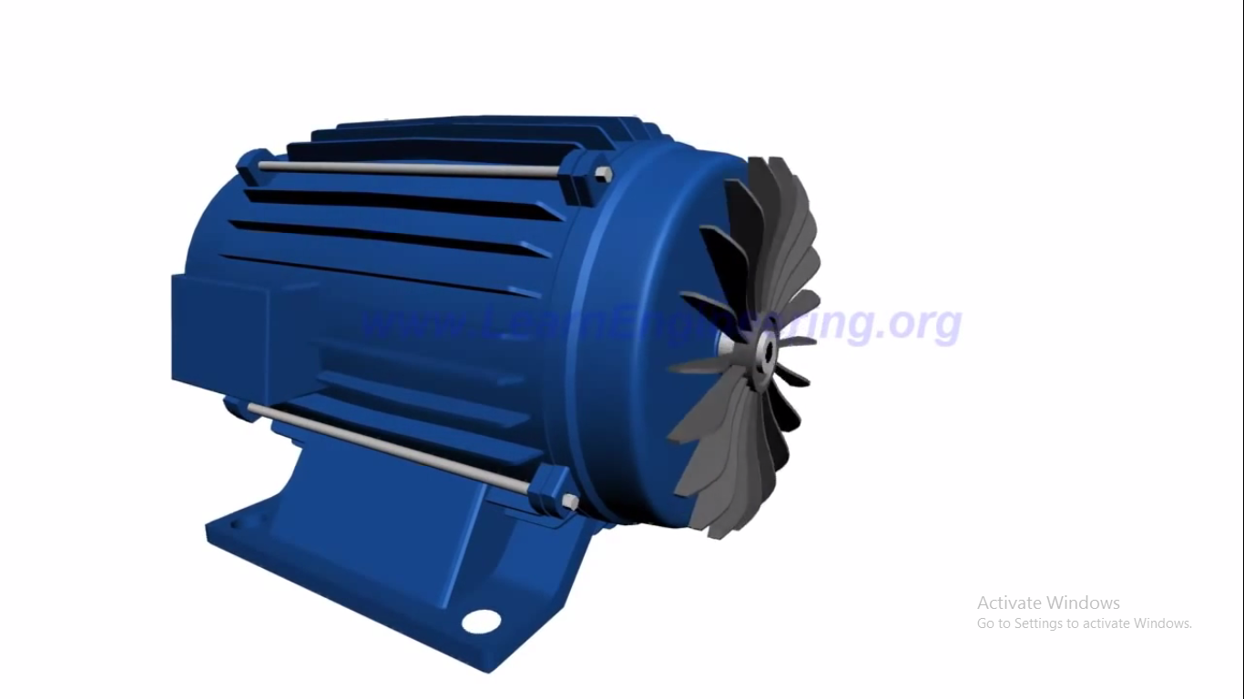
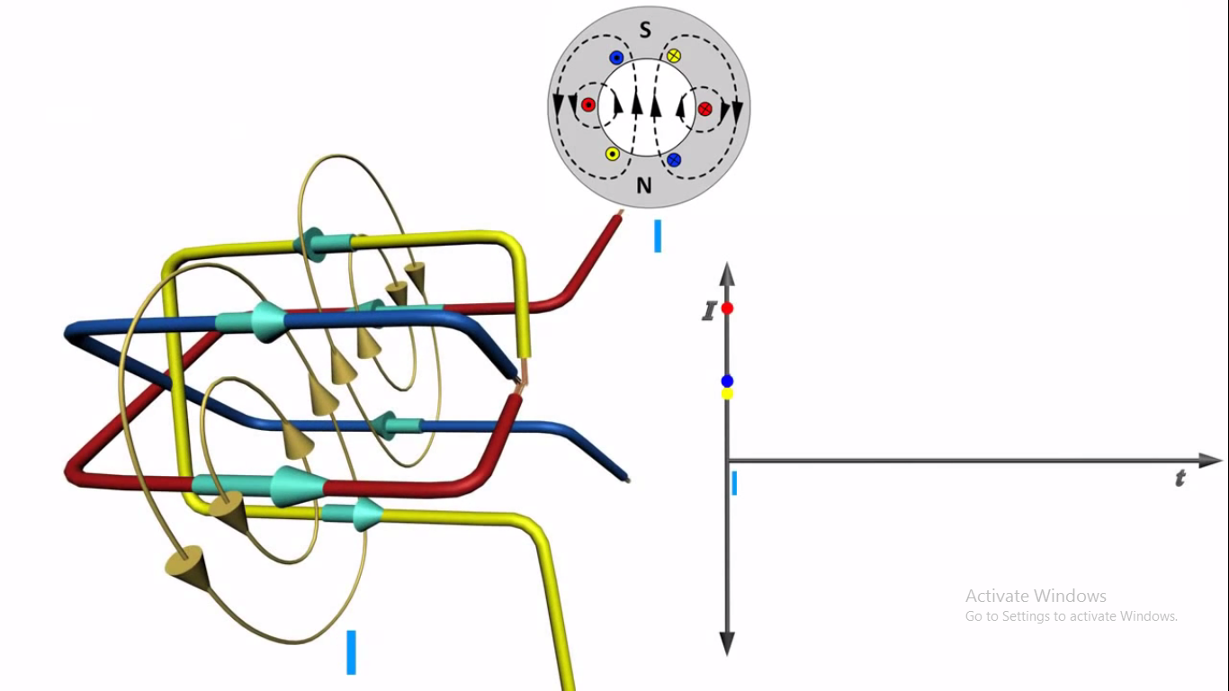
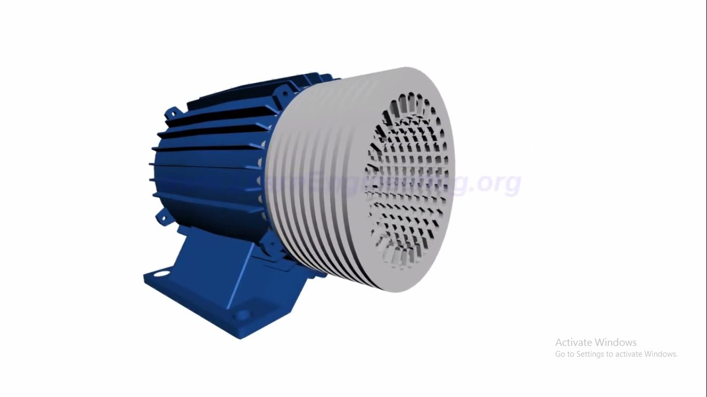
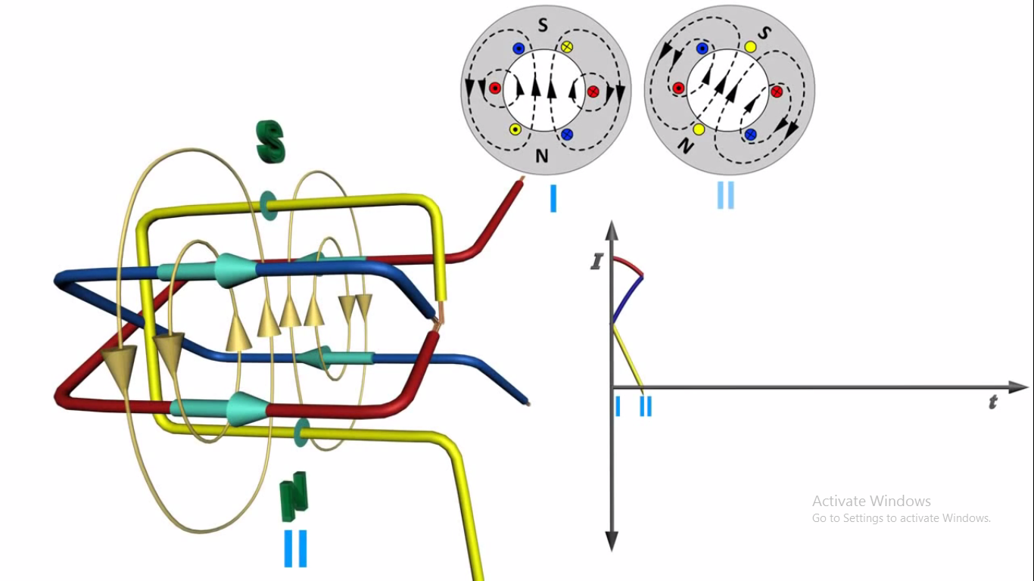
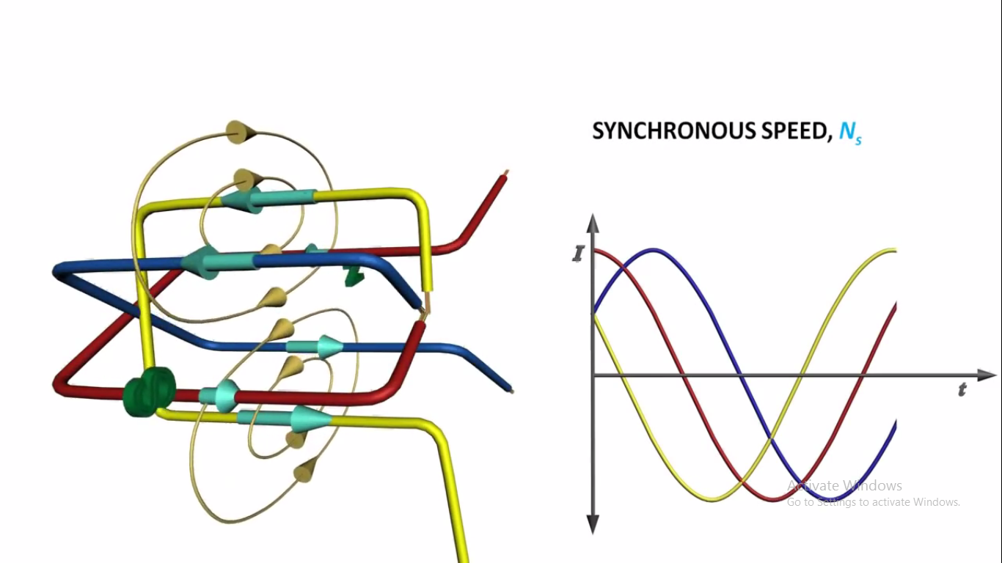
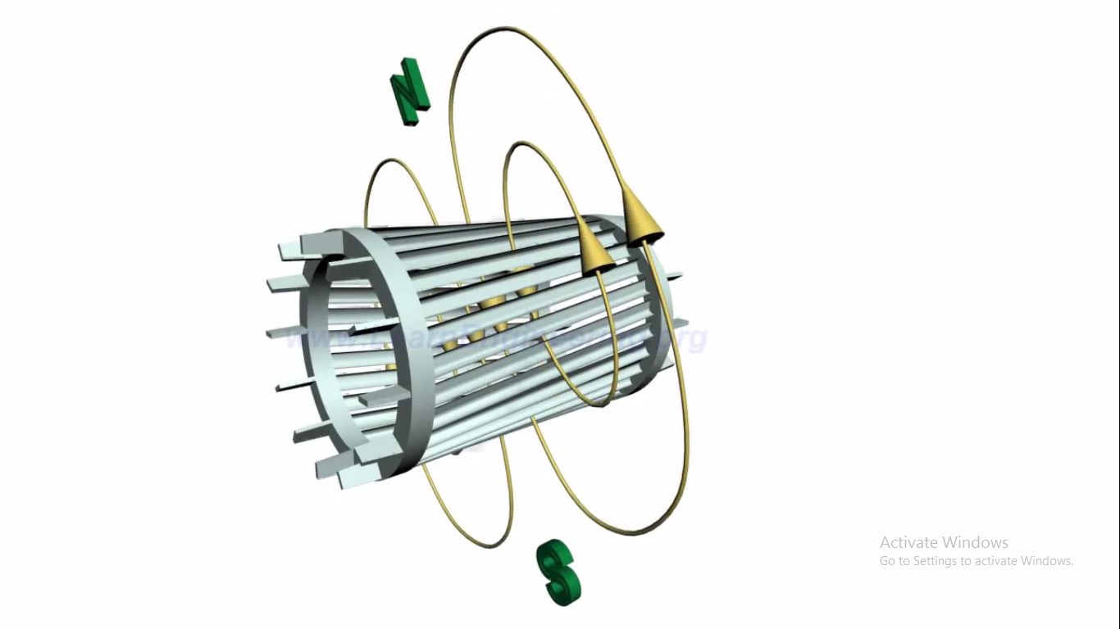
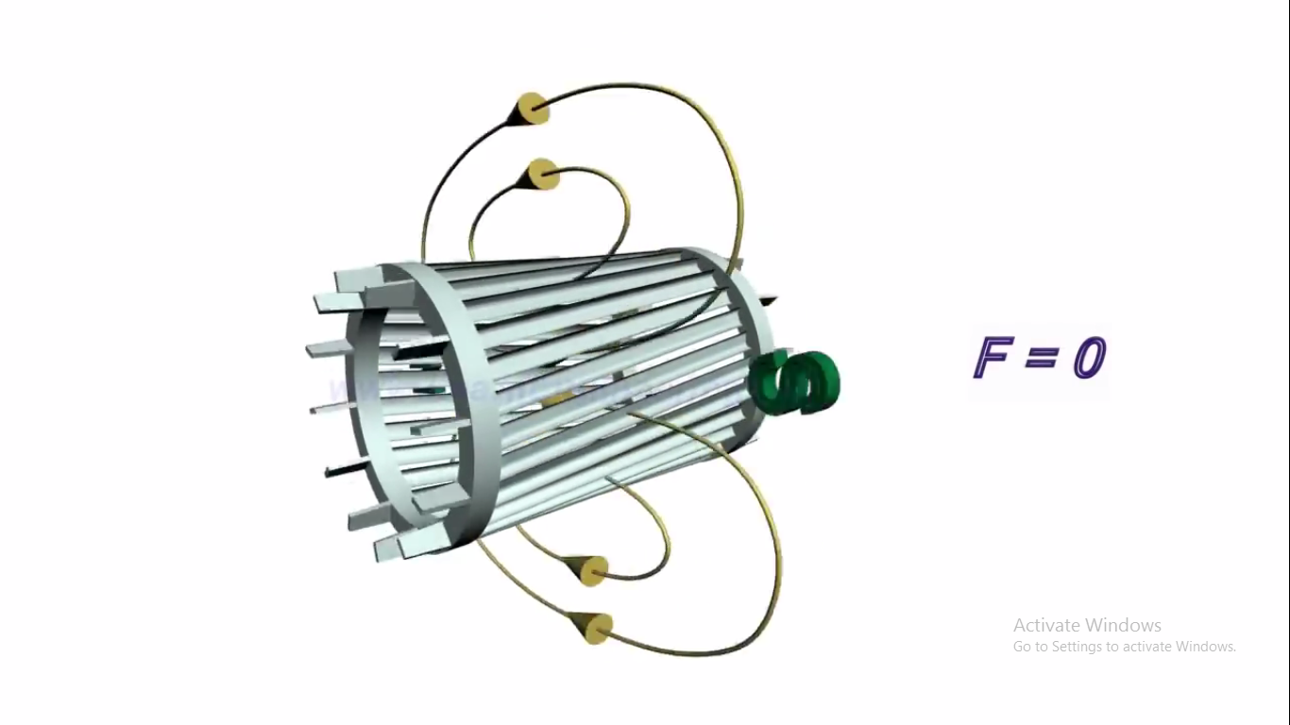
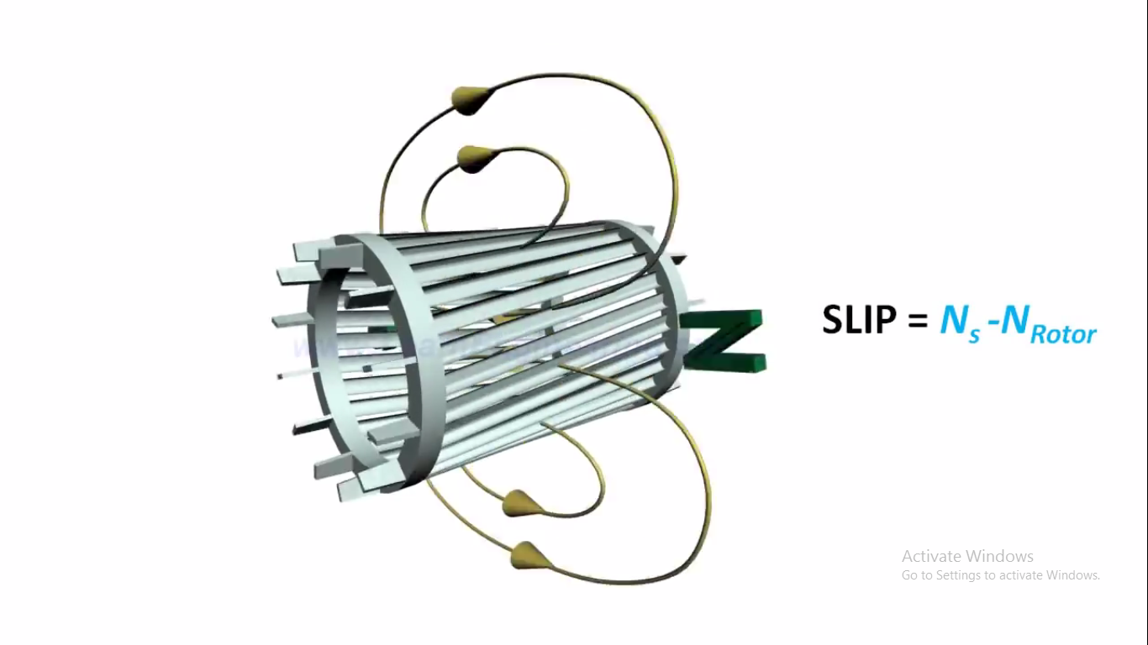
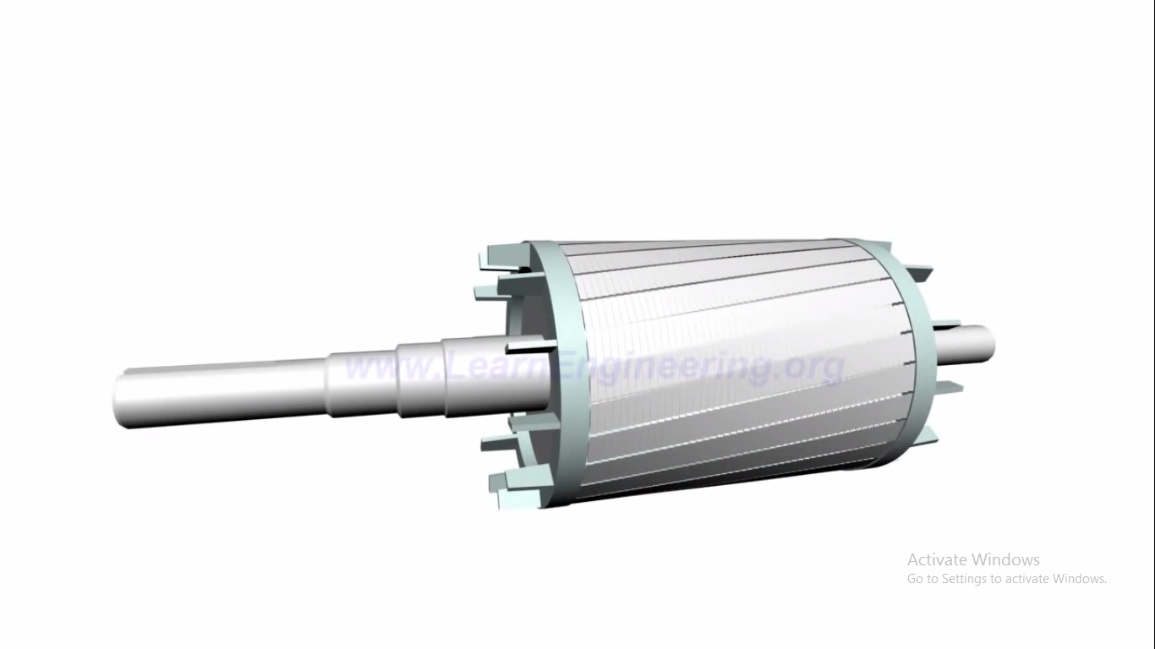
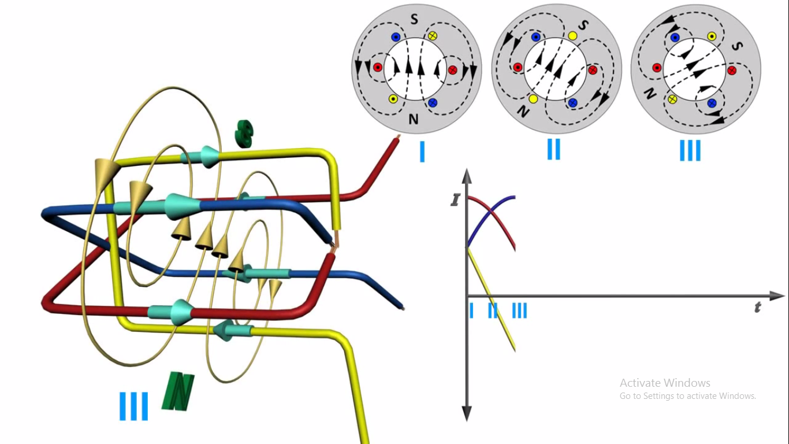
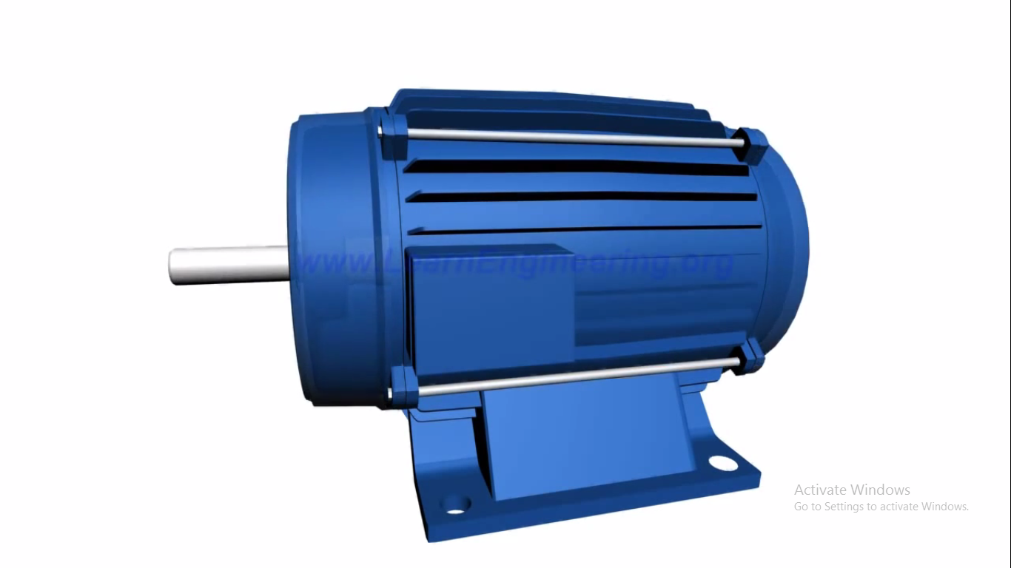
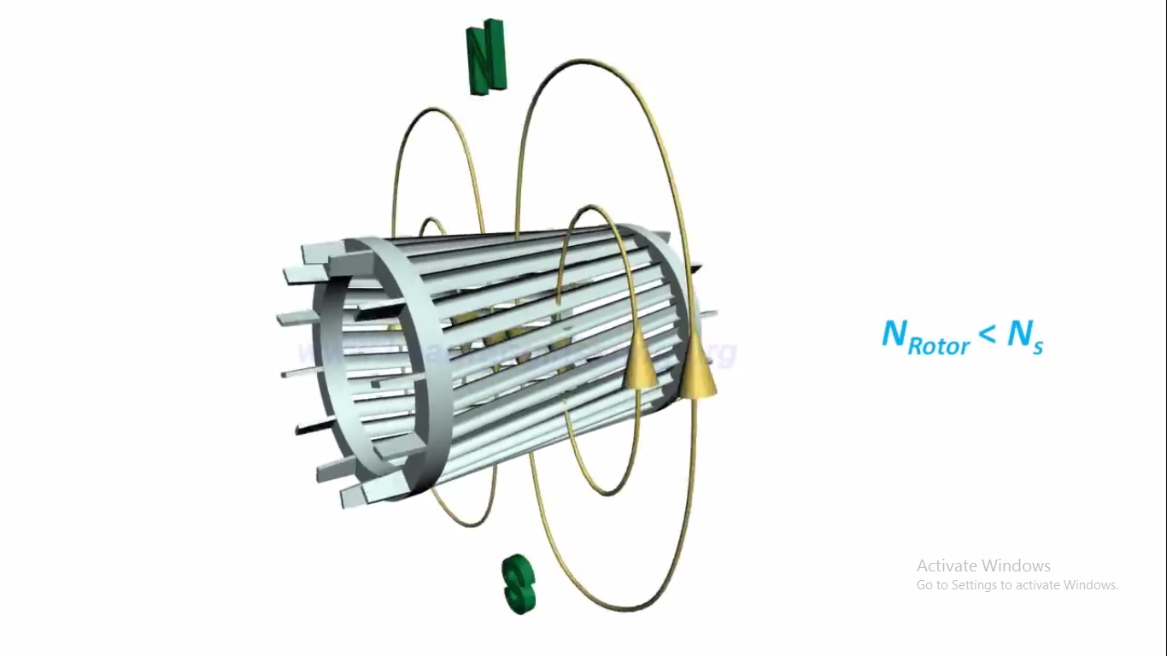
CONSTRUCTION AND WORKING OF THREE PHASE AC MOTOR

Slide 9
APPLICATION OF THREE PHASE INDUCTION MOTOR

Slide 10
Most motors in use in the world are three phase induction motors. Single phase induction motors have the advantage that they require fewer wires in their power supply, but they don't have any other advantages.
Three phase induction motors are cheaper, more efficient, more reliable, and have a much higher starting torque. It is also easy to control the speed of a three phase induction motor by using a Variable Frequency Drive (VFD).
Applications of three phase induction motor are:-
1.Refrigerator
2.Water pumps
3.Air handelers
4.Used in Tesla roadster(electric car).

Slide 11
How tesla roadster works
The heart of the Tesla Roadster is its 3-phase, 4-pole electric induction motor.
And the secret behind the rotation.
Secrets Behind the Rotation:
According to Faraday’s law an emf induced in any circuit is due to the rate of change of magnetic flux linkage through the circuit. As the rotor winding in an induction motor are either closed through an external resistance or directly shorted by end ring, and cut the stator rotating magnetic field, an emf is induced in the rotor copper bar and due to this emf a current flows through the rotor conductor. Here the relative speed between the rotating flux and static rotor conductor is the cause of current generation; hence as per Lenz's law the rotor will rotate in the same direction to reduce the cause i.e. the relative velocity.

Slide 12
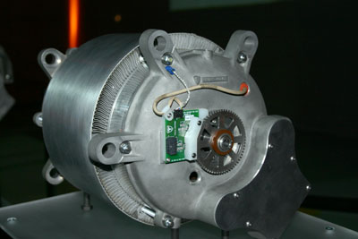
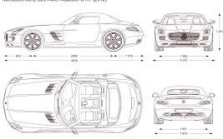
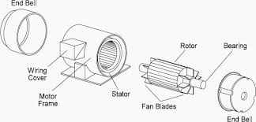
This type of motor does not require any starting device or we can say they are self starting induction motor . As they have capacitors connected with it.
The image shows a the motor of a tesla roadster.
This is the latest and the most efficient application of induction
Motor till now with a efficiency of 80 %.
The company claims that the vehicle will be able to accelerate
from 0 to 60mph in 2.5 seconds.

Slide 13
APPLICATION OF SINGLE PHASE INDUCTION MOTOR

Slide 14
In our life single phase transformer are used in small portions as in:-
1.Lathe
2.Drills
3.Mills
4.Small conveyor belts
5.Vacuum tubes
6.Screw conveyors, etc.
There are many types of single-phase electric motors but the discussion will be limited to those types most common to integral-horsepower motor ratings of 1 hp and higher and less than or equal to 1 KW.

Slide 15
How it works
Let us take example of lathe machine that how it works.
The engine lathe is an accurate and versatile machine on which many operations can be performed. These operations are:
- Plain Turning and Step Turning, Facing, Parting, Drilling, Reaming, Boring, Knurling
, Grooving, Threading , Chamfering, Filling and Polishing, Taper Turning.
Working Principle: The lathe is a machine toolwhich holds the workpiece between two rigid and strong supports called centers or in a chuck or face plate which revolves. The cutting tool is rigidly held and supported in a tool post which is fed against the revolving work. The normal cutting operations are performed with the cutting tool fed either parallel or at right angles to the axis of the work.

Slide 16
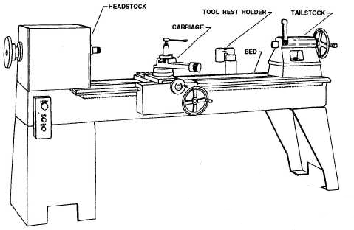

Slide 17
Comparison between single and three phase motors
Single phase induction motors are simple in construction, reliable and economical for small power rating as compared to three phase induction motors.
The electrical power factor of single phase induction motors is low as compared to three phase induction motors.
For same size, the single phase induction motors develop about 50% of the output as that of three phase induction motors.
The starting torque is also low for asynchronous motors / single phase induction motor.
The efficiency of single phase induction motors is less as compare it to the three phase induction motors

Slide 18

FUTURE PERSPECTIVE

Slide 19
Quantitative broken rotor bar fault detection for closed-loop controlled induction motors
Published in IET ELECTRICAL POWER APPLICATION ON 2 JUNE 2016
In an induction motor with broken rotor bars, stator currents contain fault-related components. The fault information propagates to voltages when the motor is in a closed-loop control.
The control has an effect on the currents and voltages. Relying solely on the currents or voltages is difficult to obtain an accurate detection and quantification of the fault. A new online diagnosis method, which takes both currents and voltages into consideration, is proposed in this study.
A fault severity factor is proposed to evaluate the extension of the fault, which is almost independent of the control parameters. Furthermore, the method can be applied to different control strategies. The effectiveness and robustness of the proposed method have been validated by experimental results.

Slide 20
USING IT AS A 6 PHASE INDUCTION MOTOR The article considers the areas of applying multiphase induction motors. Their advantages against three phase motors have become the main reason for employing them in multiphase drives. The paper deals with the six-phase induction motor having two similar three phase windings in the stator shifted by 30 degrees in space and three phase windings in the rotor. Differential equations for this motor are presented and transformed to dq synchronous reference frame. The transformed equations are expressed in a matrix form and solved by MATLAB software using the Dormand-Prince (ode45) method(DOPRI). The transient characteristics of the torque, speed and current of the six-phase induction motor are calculated and discussed.

Slide 21
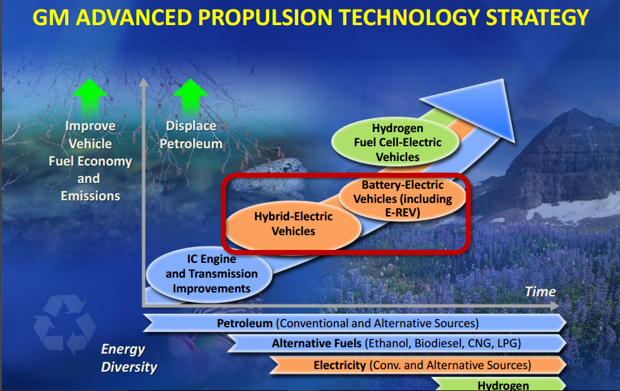
Materials Challenges and Opportunities for Hybrid and Electric Vehicles
GENERAL MOTORS COMPANY

Slide 22
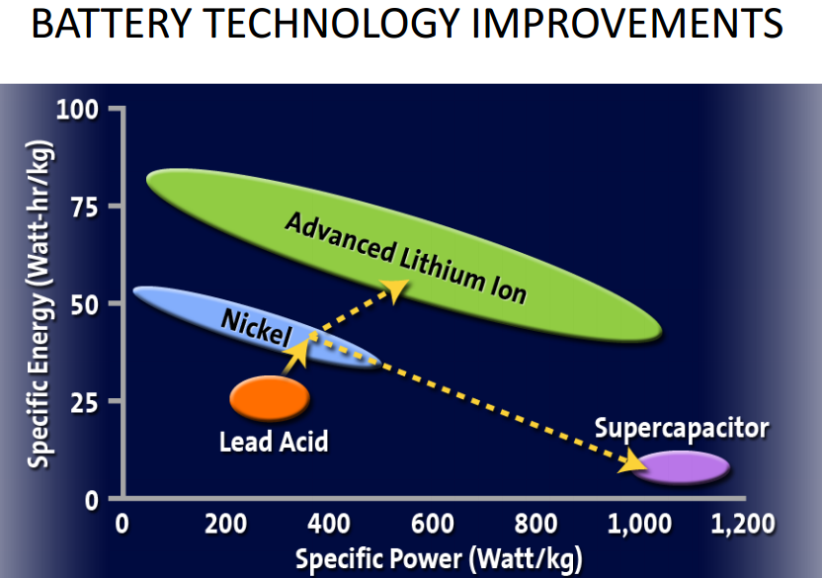

Slide 23
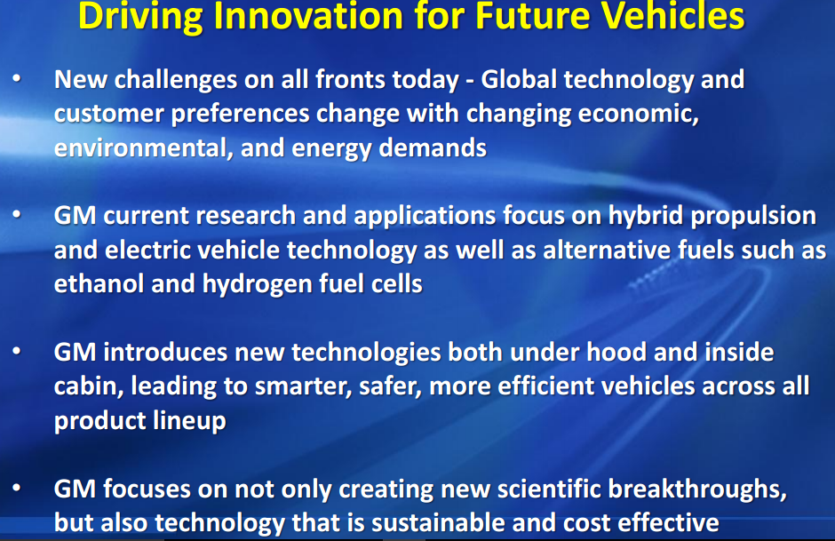

Slide 24
LATEST STUFF

Slide 25
Latest advancement in Induction Motor
Copper Rotor Motors are ‘Ultra-Efficient’
Electric motors in U.S. industrial applications account for more than 60 percent of electricity use; even small increases in efficiency improvements can make a big difference in energy savings.
Induction AC motors include die-cast copper rotors which offer increased electrical energy efficiency, lower operating temperature,
extended motor life, and reduced weight and size. In fact, these ultra-efficient motor designs have total losses that are 6.6 to 15.5 percent below those of comparable Premium efficiency motors available in market.

Slide 26
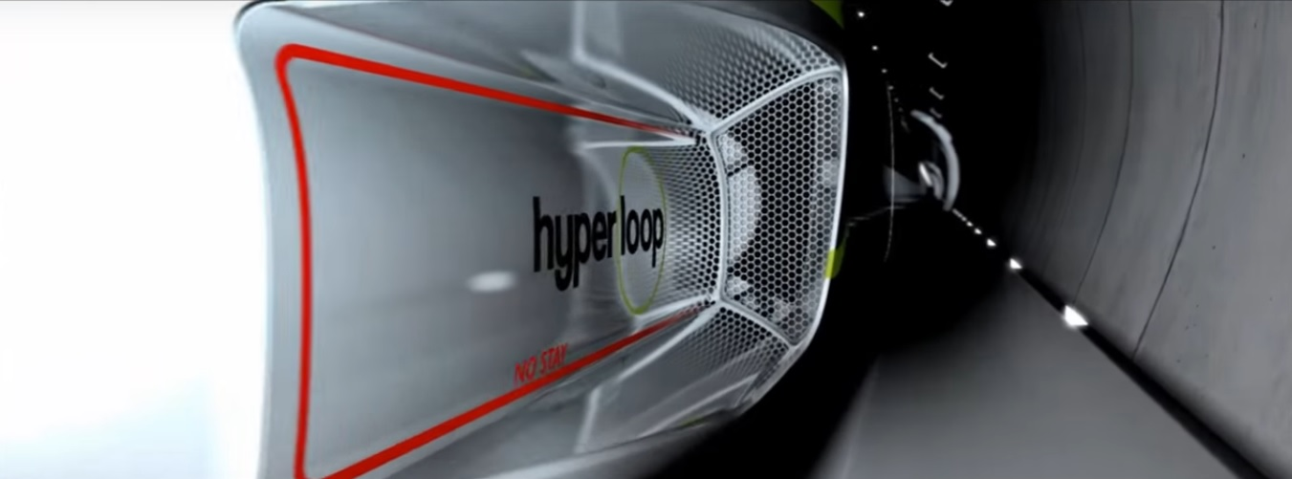
Solution to Pollution
ELECRTIC CAR :
Hyperloop Train: The train of the future It would be a solar-powered transportation system called the ”hyperloop” to move people and cars across long distances and will be based on induction motor.
The Hyperloop is a conceptual high-speed transportation system put forward by entrepreneur Elon Musk, incorporating reduced-pressure tubes in which pressurized capsules ride on an air cushion driven by linear induction motors and air compressors

Slide 27
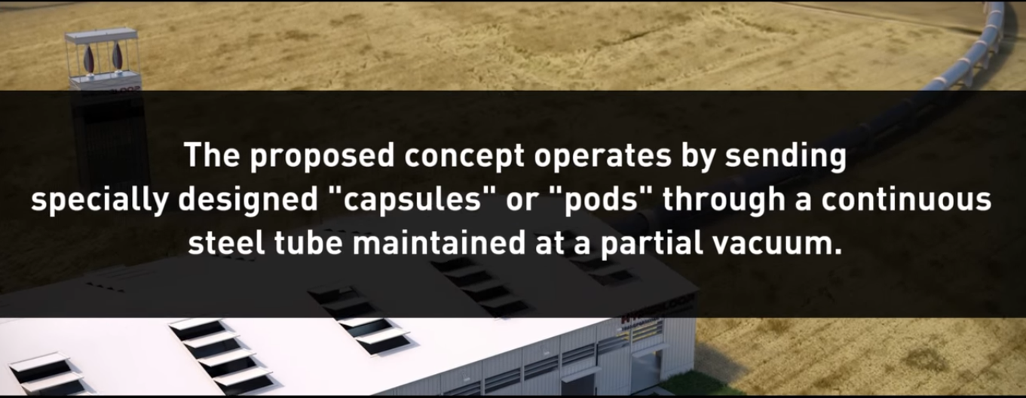

Slide 28
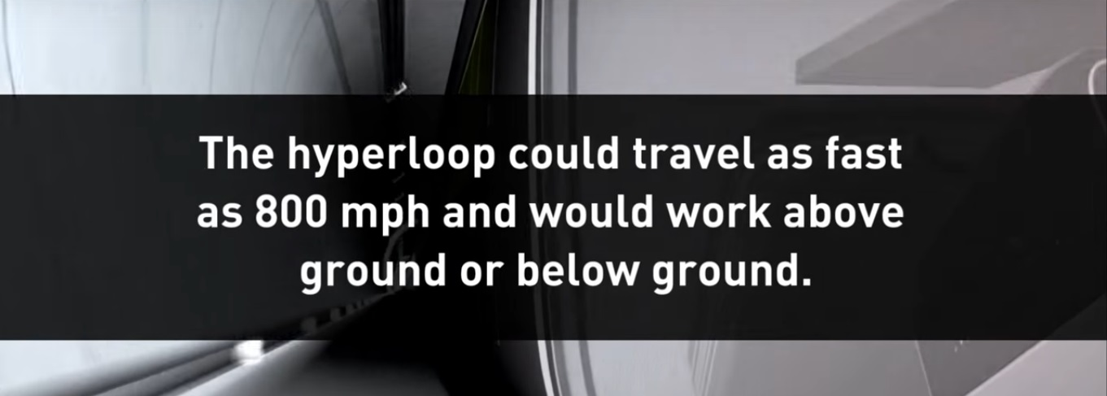

Slide 29
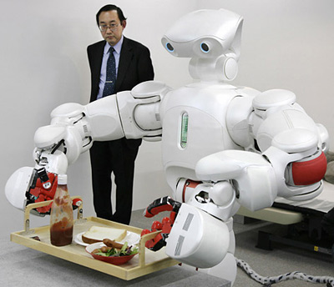
Induction Motors in Robotics
Robots are our future... And they are incomplete without induction motors.... So we require more efficient.. Motors for them....
Robots can be very complex devices
requiring a wide variety of motor-driven
movements

